Slide 1

CCPS 506
Comparative Programming Languages
Fall 2019
Lecture 5: Elixir loose ends, type systems

Slide 2

Course Administration
Assignment description for Elixir is posted
If you liked Elixir, you can start working on the Elixir version.
Eventually (during or after reading week) I will post test cases for your assignments.
You can verify that your code is correct for simple cases

Slide 3
Course Administration
No class next week (Oct 12th), it’s reading week
Midterm will be the week after reading week. Oct 19, during class.
Will cover Smalltalk, Elixir, and related concepts.
Short answer questions covering concepts
Code tracing, what is the output, etc.
I won’t ask you to write programs
I will only ask you to answer questions about code provided.
Duration will be 3 hours – I doubt it will take most of you that long.

Slide 4

Any Questions?

Slide 5
Today
Finish up Elixir
Type Systems
Static VS Dynamic
Weak VS Strong
Go over previous labs

Slide 6
Let’s Get Started!

Slide 7
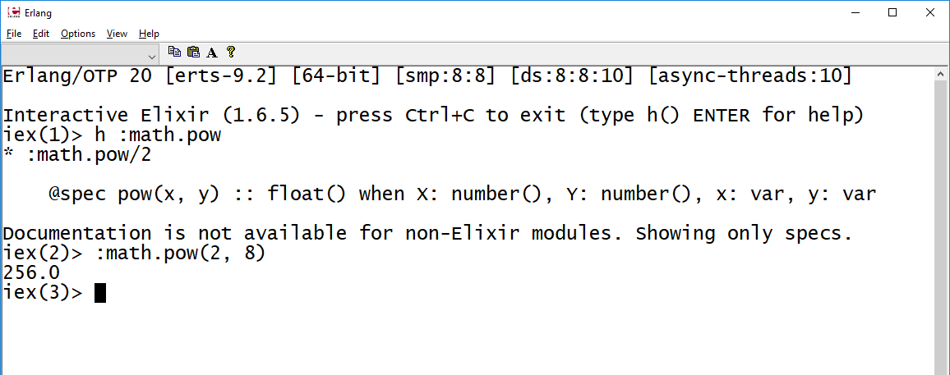
:math.pow()
Loose End
Elixir inherits this from Erlang:
Returns float

Slide 8
Enum

Slide 9
Enum
A set of algorithms for enumeration over enumerables! (lists, tuples, and more)
Enum applies functions to lists in various ways. We will see a few:
Enum.all?
# Entire collection must evaluate to true for a given condition
Enum.any?
# Any value in the collection must evaluate true
Enum.map
# Apply a function to every element in the collection
More: https://elixirschool.com/en/lessons/basics/enum/

Slide 10
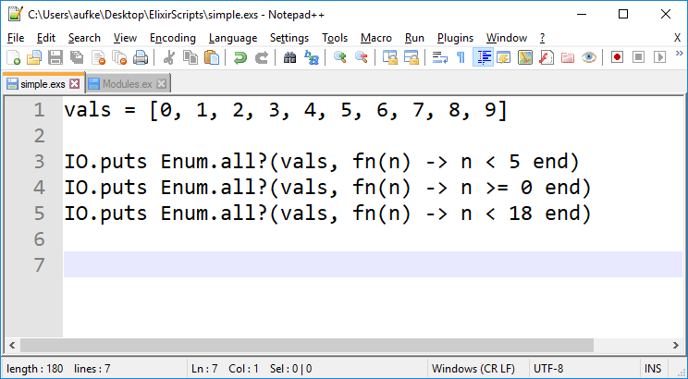
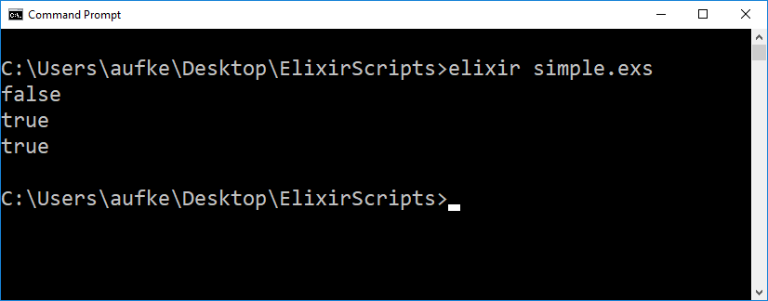
Enum.all?
Entire collection must evaluate to true for a given condition
Pass list as first arg
Anon function as second arg

Slide 11

Enum.any?
Any value in collection must evaluate to true for a given condition

Slide 12
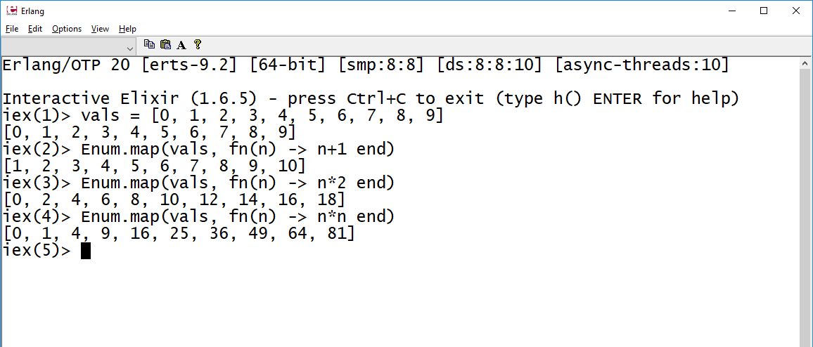
Enum.map
Very useful! Apply a function to every element

Slide 13
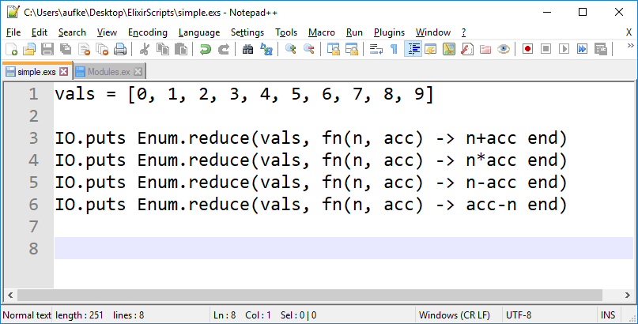
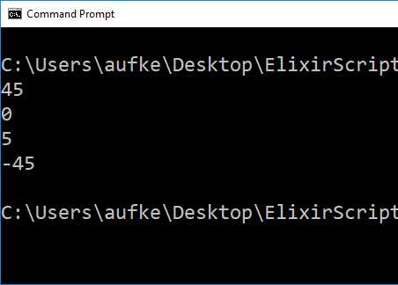
Enum.reduce
Distill collection to single value based on some function
acc is the running value
By default, initialized to first element in list

Slide 14
Stream

Slide 15
Streams
Similar to Enum, but Streams are lazy!
Enum functions are strict/eager.
The result of an Enum is the list that results from applying it:
iex> list = [1, 2, 3, 4, 5]
[1, 2, 3, 4, 5]
iex> Enum.map(list, &(&1 + 1))
[2, 3, 4, 5, 6]

Slide 16
Streams
Similar to Enum, but Streams are lazy!
Stream and Enum share many functions.
What is the result of evaluating Stream.map?
iex> list = [1, 2, 3, 4, 5]
[1, 2, 3, 4, 5]
iex> Stream.map(list, &(&1 + 1))
#Stream<[
enum: [1, 2, 3, 4, 5],
funs: [#Function<48.103564624/1 in Stream.map/2>]
]>

Slide 17
iex> list = [1, 2, 3, 4, 5]
[1, 2, 3, 4, 5]
iex> Stream.map(list, &(&1 + 1))
#Stream<[
enum: [1, 2, 3, 4, 5],
funs: [#Function<48.103564624/1 in Stream.map/2>]
]>
That’s not a list! Stream is its own type.
Think of a stream as a recipe for producing the transformed list.
Here, our stream is a recipe for adding 1 to every element.
We haven’t actually done the cooking!
Why is this useful?

Slide 18
Streams
Consider the following script:
list = [1, 2, 3, 4, 5]
r1 = Enum.map(list, &(&1 + 1)) |>
Enum.map(&(&1 * 3)) |>
Enum.map(&(&1 / 2))
An aside: Pipe is useful here!
Output list from Enum piped into next call as 1st arg.
Thus, subsequent Enum calls only have 1 arg.
How many new lists are created when we evaluate this?
One for each Enum call! Very inefficient.

Slide 19
Streams
list = [1, 2, 3, 4, 5]
r1 = Stream.map(list, &(&1 + 1)) |>
Stream.map(&(&1 * 3)) |>
Stream.map(&(&1 / 2))
r1 is a recipe for a new list
At this point, no new list(s) have been created!
list = [1, 2, 3, 4, 5]
r1 = Stream.map(list, &(&1 + 1)) |>
Stream.map(&(&1 * 3)) |>
Enum.map(&(&1 / 2))
If we finish with an Enum call, the stream is applied.
Only one new list created

Slide 20
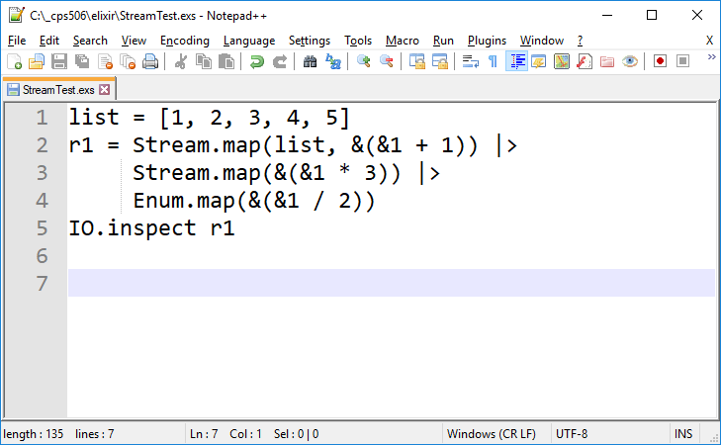
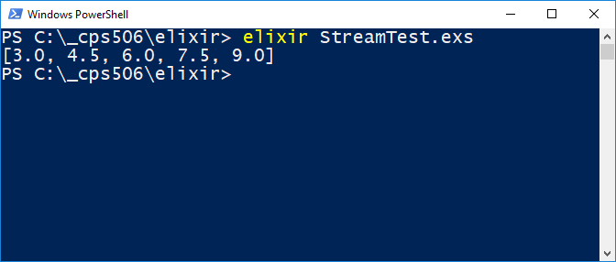

Slide 21
Apply the Stream?
Can also use Enum.to_list
list = [1, 2, 3, 4, 5]
r1 = Stream.map(list, &(&1 + 1)) |>
Stream.map(&(&1 * 3)) |>
Stream.map(&(&1 / 2))
Enum.to_list(r1)

Slide 22
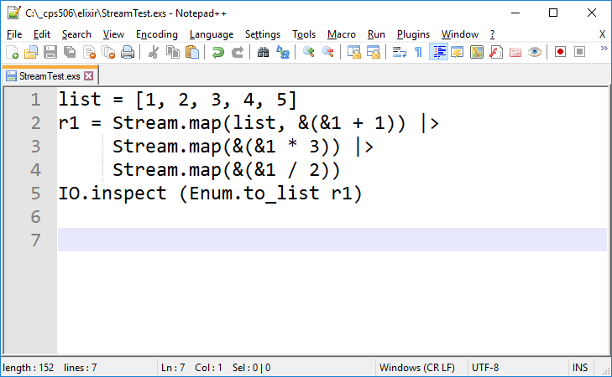
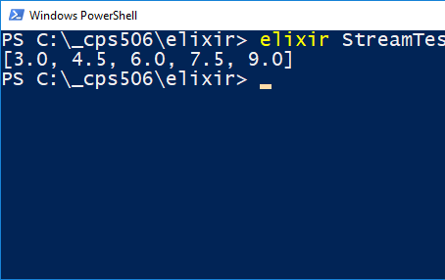
Lots more: https://hexdocs.pm/elixir/Stream.html

Slide 23
List Comprehensions
for:
Generating
Filtering
Operating
Produces a list when it’s done!

Slide 24
List Comprehensions
NOT THE SAME AS A FOR LOOP.
NOT GENERAL PURPOSE.
DON’T EVEN.

Slide 25
List Comprehensions
Very much like comprehensions in Python
Three parts:
Generator
Filter
Collector
Comprehensions are syntactic sugar for things we could otherwise do with Enum or recursive functions

Slide 26
List Comprehensions
iex> Enum.map([1, 2, 3, 4], &(&1*&1))
[1, 4, 9, 16]
iex> for n <- [1, 2, 3, 4], do: n*n
[1, 4, 9, 16]
Generator: Any enumerable
In this case, a plain old list

Slide 27
List Comprehensions
iex> Enum.map([1, 2, 3, 4], &(&1*&1))
[1, 4, 9, 16]
iex> for n <- [1, 2, 3, 4], do: n*n
[1, 4, 9, 16]
iex> for n <- 1..4, do: n*n
[1, 4, 9, 16]
Used to produce list [1, 2, 3, 4]
Can generate large lists this way
Note: 1..4 is NOT itself a list!
It is a Range

Slide 28
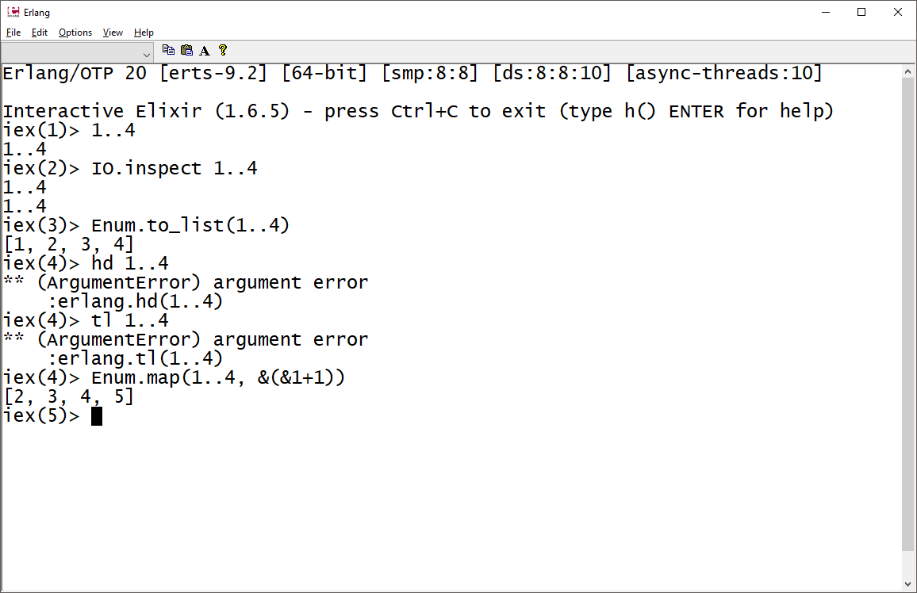

Slide 29
List Comprehensions
iex> for n <- 1..4, do: n*n
[1, 4, 9, 16]
List comprehensions produce lists
Generators like the above are lazy (Range)
Operate on elements one at a time, discarding previous.
That is, at no point do we produce the complete list [1, 2, 3, 4] in memory.
https://hexdocs.pm/elixir/Range.html

Slide 30
List Comprehensions: Pattern Matching
iex> vals = [good: 1, good: 2, bad: 3, good: 4]
Keyword list!
iex> vals = [{:good, 1}, {:good, 2}, {:bad, 3}, {:good, 4}]
[good: 1, good: 2, bad: 3, good: 4]

Slide 31
List Comprehensions: Pattern Matching
iex> vals = [good: 1, good: 2, bad: 3, good: 4]
[good: 1, good: 2, bad: 3, good: 4]
iex> for {:good, n} <- vals, do: n*n
[1, 4, 16]
Pattern matching is powerful
We can also filter in a Boolean fashion

Slide 32
List Comprehensions: Filtering
iex> fun = &(rem(&1, 3) == 0)
#Function<6.99386804/1 in :erl_eval.expr/5>
iex> for n <- 1..20, fun.(n), do: n
[3, 6, 9, 12, 15, 18]
Filter is optional
Include it after generator if desired
Only elements that evaluate to true when filtered will make it to the do: block

Slide 33
List Comprehensions: Filtering & Matching
iex> list = [a: 1, b: "2", a: 3.0, a: "4.0", b: {5}, a: ["6.0"]]
[a: 1, b: "2", a: 3.0, a: "4.0", b: {5}, a: ["6.0"]]
iex> for {:a, n} <- list, is_number(n), do: n
[1, 3.0]
Nothing semantically new here
Anything we can do with comprehensions we can do with Enum or our own functions.
It might require more syntax, but we can do it.
Comprehensions can be used to create concise code

Slide 34
List Comprehensions: In 2D?
iex> for i <- [:a, :b, :c], j <- [1, 2], do: {i, j}
[a: 1, a: 2, b: 1, b: 2, c: 1, c: 2]
We get a keyword list containing combinations of all elements from both generators

Slide 35
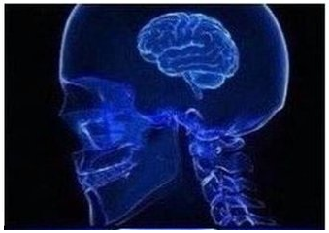

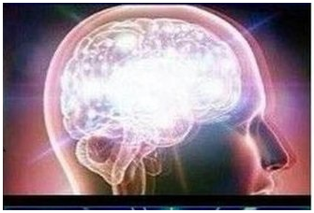

List Comprehensions
Looping
Recursion
Enum
Stream

Slide 36

List Comprehensions
Looping
Recursion
One-line list comprehension
Enum
Stream

Slide 37
Elixir Processes (In Brief):
Elixir is built on a process model. Recall:
Elixir code runs inside lightweight threads of execution.
Isolated, exchange information via message passing.
Not uncommon to have hundreds of thousands of processes running concurrently in same VM.
Note: These are NOT operating system processes!
Extremely lightweight in terms of CPU and memory
A process need not be an expensive resource

Slide 38
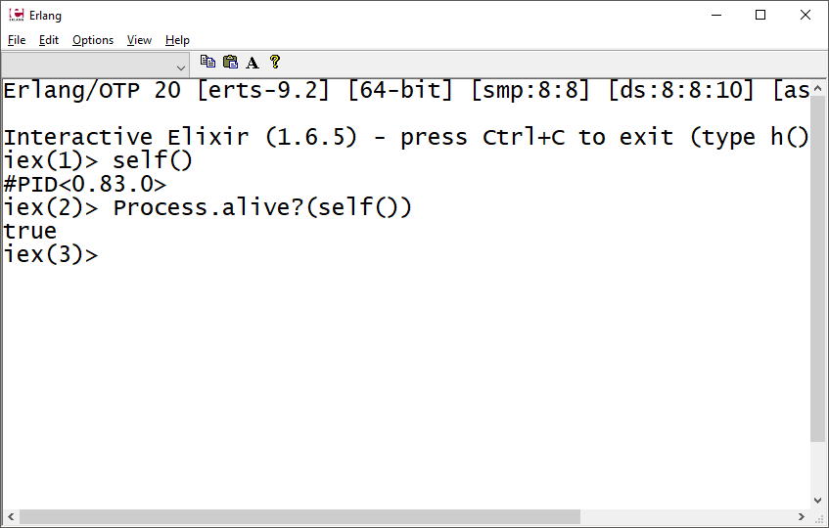
Elixir Processes
Playing with processes:
self() Returns PID of current process.
In this case, it’s the PID of our interactive shell session
Process.alive?() tests if a process is currently active.
We can spawn functions as processes!

Slide 39
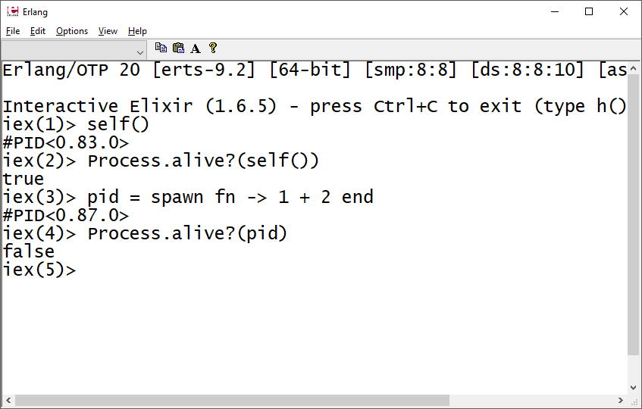
Elixir Processes
spawn function takes a function as an argument and returns its PID once spawned.
Function executes when spawned
Process is not active, the function is not currently executing

Slide 40
Elixir Processes: Send & Receive
iex> send(self(), {:Hello, “World”})
{:Hello, "World"}
send/2 can be used to send a message (!!!) to a process (by PID)
This message goes into a mailbox (CCPS590) and can be received using the receive/1 function
When invoking receive, it will go through the messages in the mailbox and attempt to match the messages with the provided patterns

Slide 41
Elixir Processes: Send & Receive
iex> send(self(), {:Hello, “World”})
{:Hello, "World"}
iex> receive do
...> {:Hello, msg} -> msg
...> {:World, msg} -> "won't match"
...> end
"World"
iex>
Once the message is received, it is consumed!
We can’t receive the same message twice.
Subsequent receive calls will be blocking

Slide 42
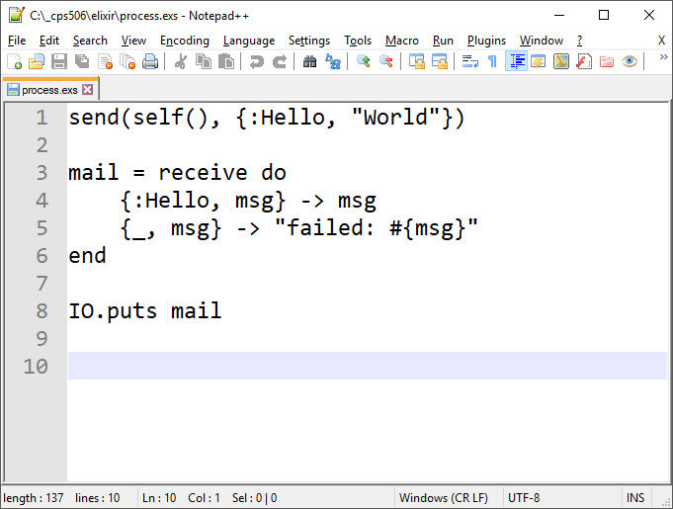
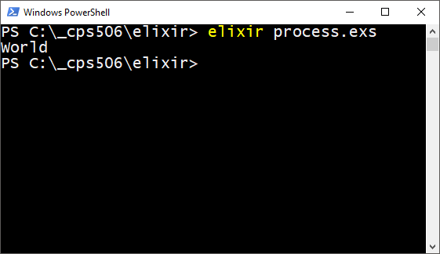
Elixir Processes: Send & Receive

Slide 43
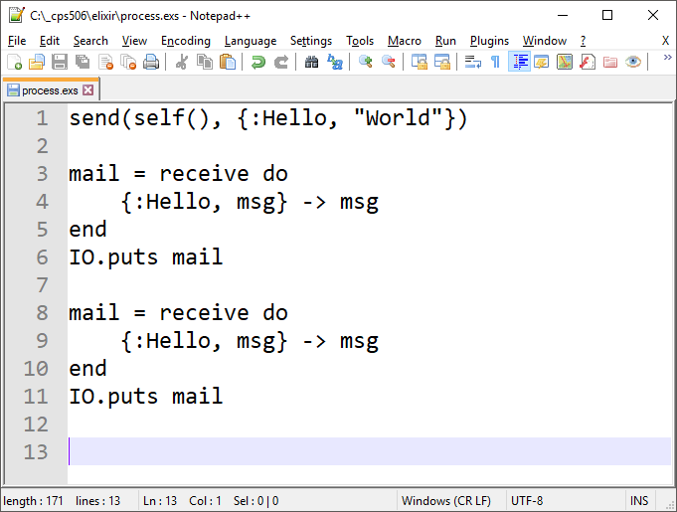
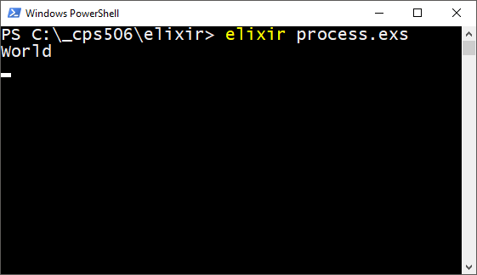
Elixir Processes: Send & Receive
Receive is blocking!
We sent one message, and received it.
We then try and receive again, but the mailbox is empty.
Process sits and waits.

Slide 44
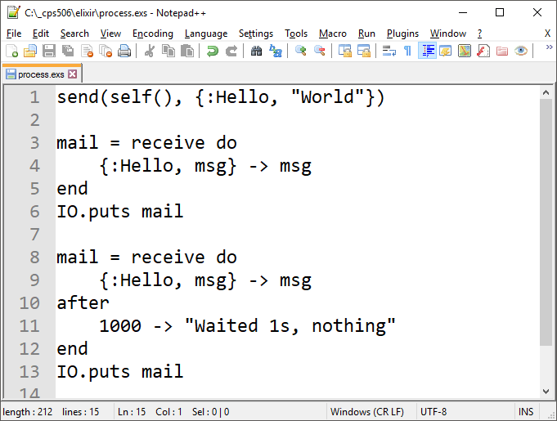
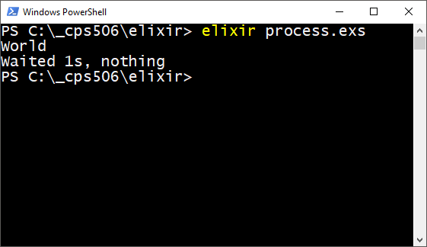
Elixir Processes: Send & Receive

Slide 45
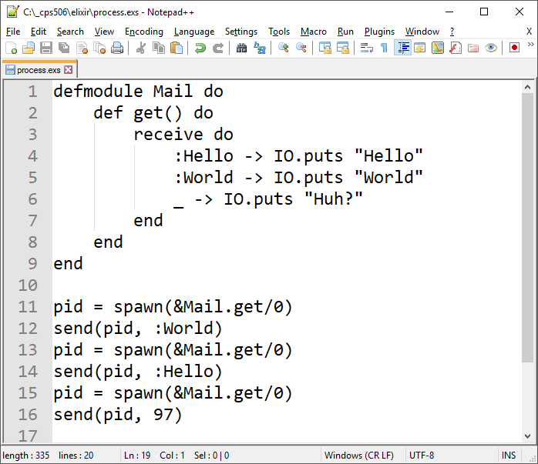
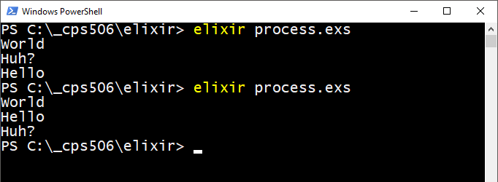
Elixir Processes: Send & Receive
Spawning a function as a process executes that function.
A blocking receive can be used to wait for messages.
Once the function receives a message, it will pattern match.
Receive only blocks once! Hence, we have to spawn the function three times.
Race condition!
Execution is interleaved.
Up to scheduler.

Slide 46
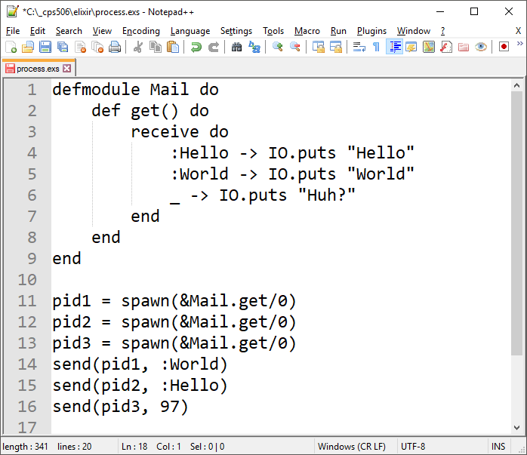
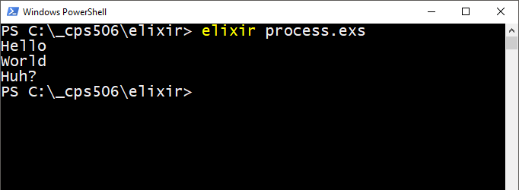
Elixir Processes: Send & Receive
Spawn all three, send each a message.
Which of the child process gets chosen to execute is up to the scheduler.

Slide 47
Elixir Processes
This has been a taste. There’s lots more.
Elixir is famous for powerful concurrent processing.
Processes can be used to emulate the object message passing model in languages like Smalltalk.
If you understand a bit about concurrency from 209 or 590, check it out.
https://elixir-lang.org/getting-started/processes.html

Slide 48



Slide 49
Functional Programming & Elixir
We saw:
Functions as first class entities
How to create and pass anonymous functions as arguments
How to return anonymous functions
Immutable data – variables (names) are bound and matched using =
Collections are not modified.
Enum.map returns a new collection
Recursion – Loops are tail-recursive (ideally) functions calls.
Enum functions work this way behind the scenes
Elixir provides many syntax contrivances that make code more familiar to programmers accustomed to the imperative style.

Slide 50
Functional Programming & Elixir
Flow control is not built into the language as syntax constructs
This suggests there’s no iteration in the typical sense of the word.
Looping is accomplished with control structures in imperative languages.
If control structures are functions, that means looping is always recursive.
However
This refers to the high level implementation only.
Machine instructions are optimized into iteration via tail recursion.

Slide 51
Elixir Syntax
Dynamically typed
Type inferred at run-time
Need not explicitly specify type upon declaration
Provides syntax conveniences to make it more intuitive to programmers accustomed to imperative languages
Interactive shell provides help/search functionality
https://media.pragprog.com/titles/elixir/ElixirCheat.pdf

Slide 52
Elixir Syntax
Reserved words
true, false, nil
Used as atoms
when, and, or, not, in
Used as operators
fn
Used for anonymous function definitions
do, end, catch, rescue, after, else
Used in do/end blocks
https://github.com/elixir-lang/elixir/blob/master/lib/elixir/pages/Syntax%20Reference.md

Slide 53
Further Reading
https://elixir-lang.org/getting-started/introduction.html
https://elixirschool.com/en/lessons/basics/basics/

Slide 54

Elixir Popularity

Slide 55
Elixir Popularity
https://techbeacon.com/5-emerging-programming-languages-bright-future
This list also includes Rust!

Slide 56

(After reading week)

Slide 57

Type Systems

Slide 58
Type System
A set of rules that assigns a property called type to constructs of a program.
These constructs include variables, functions, expressions, etc.
The whole point is to reduce bugs.
For example, if a pattern of 32 bits has been encoded using 2s complement, we don’t want to read it using IEEE 754
And we can do this in many languages!

Slide 59
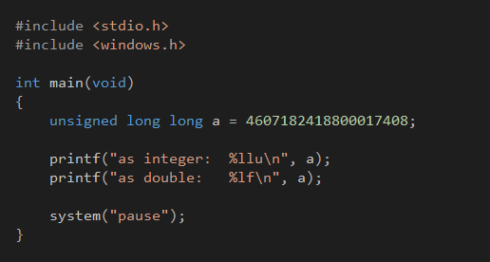
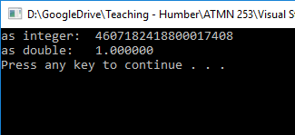
Declare large 64-bit integer
Print as int, print as double
The 2s comp bit pattern was read as an IEEE 754 double.
(The integer constant was deliberately picked to produce a bit pattern that would yield 1.000000 as double)

Slide 60
Type Checking
Clearly, type checking isn’t performed in the context of a printf statement in C++
Think of type checking as trying to fit puzzle pieces together.
Does the output type of a function match the variable we’re trying to store it in?
Do the input arguments to a function match the types indicated in the parameter list?
If no, will we allow implicit conversion?

Slide 61
Static VS Dynamic
When are types checked?
Statically typed languages perform type checking at compile time
Checked in the process of converting source code to machine code
Java, C, C++, etc.
Dynamically typed languages perform type checking at run-time
Checked on the fly while instructions are being executed.
Statically Typed languages: C/C++, Java, Haskell, Rust
Dynamically Typed languages: Smalltalk (with caveat), Elixir

Slide 62
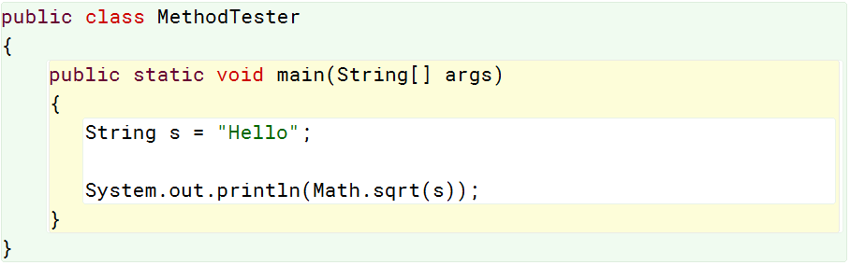

Static Type Checking

Slide 63
In dynamically typed languages, every operation knows the types for which it is valid.
Providing invalid arguments or operands will yield a run-time error which may or may not be recoverable
Such things can be anticipated and mitigated in various ways, such as verifying type explicitly

Slide 64
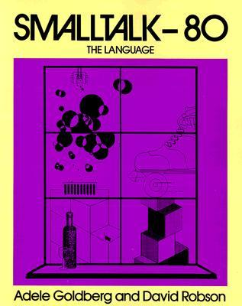
Dynamic Type Checking (well…)
factorial: n
| fac |
fac := 1.
n isInteger
ifTrue: [1 to: n do:
[:a | fac := fac*a.].
^fac
]
ifFalse: [
^'Bad input’
].
In Java, the parameter would be defined as int
Compile error occurs if arg isn’t int, or can’t be implicitly cast as an int.
Of course polymorphism complicates this (instanceof)
Still statically typed. Compiler checks what it can

Slide 65
Dynamic Type Checking (well…)
#(1 2 3 4) + 18.2
Does Smalltalk have type errors in the strict sense of the term?
Different objects understand different messages.
A “type error” occurs when an object doesn’t have a method to handle a particular message.
Type errors in Smalltalk are more like “method not found” errors.
Above, the error occurs because the Array class doesn’t have a method for symbolic operator #+
Smalltalk enthusiasts debate this.

Slide 66
Dynamic Type Checking
defmodule UserMath do
def fib(n) when not is_integer(n) or n < 0 do
:error
end
def fib(0), do: 0
def fib(1), do: 1
def fib(n), do: fib(n-2) + fib(n-1)
def fac(n) when not is_integer(n) or n < 0 do
:error
end
def fac(0), do: 1
def fac(n), do: n*fac(n-1)
end

Slide 67
Static VS Dynamic
Advantages? Disadvantages?
Static:
Reliably find errors at compile time.
Code will execute faster if types are assumed to be correct at run time.
Type-specific optimization can be performed at compile time.
I.e., integer arithmetic is faster than floating point
Dynamic:
Compilers run faster
Interpreters can dynamically load new code
Smalltalk, MATLAB, iex
Easier code reuse

Slide 68
Static VS Dynamic
Advantages? Disadvantages?
There is much disagreement among programmers about just how much of a problem type errors are in the grand scheme of things.
Does the added cost of developing in a statically typed language make sense if type-related bugs are but a tiny fraction?
Of the type-related bugs that occur, what proportion of those would have been solved by a type checker anyway?
They aren’t perfect after all.

Slide 69
Untyped?
Huh?
In Smalltalk, “type” errors occur when an object doesn’t know how to handle a particular message.
This, strictly speaking, has nothing to do with type!
We don’t get a type error, we get a method-not-found error
Untyped or dynamically typed is an issue CS academics and researchers argue about.
We don’t have rigorous, universally accepted definitions for this stuff.
Speaking of rigorous definitions…

Slide 70

Strong VS Weak Typing

Slide 71
Strong VS Weak (or Loose)
Refers to how strict statically typed languages are at compile time
There is actually no universally accepted definition of what constitutes strong or weak typing
Of strongly typed languages:
1974: “Whenever an object is passed from a calling function to a called function, its type must be compatible with the type declared in the called function."
Compatible is open to interpretation. Is float compatible with double? Integer with short integer?

Slide 72
Strong VS Weak (or Loose)
Refers to how strict statically typed languages are at compile time
1974: “Whenever an object is passed from a calling function to a called function, its type must be compatible with the type declared in the called function."
1977: “In a strongly typed language each data area will have a distinct type and each process will state its communication requirements in terms of these types."
Parameter lists, return types, etc.

Slide 73
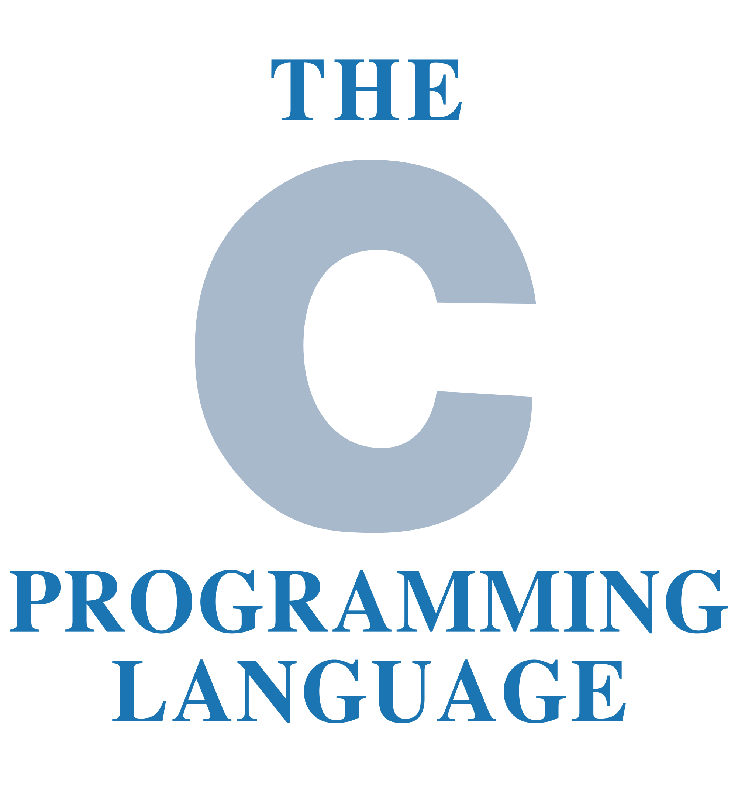
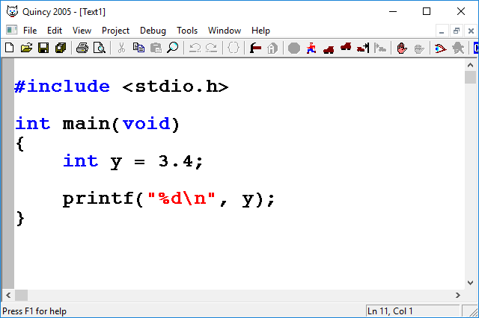
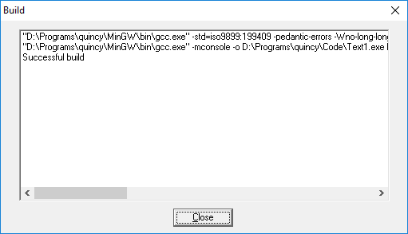

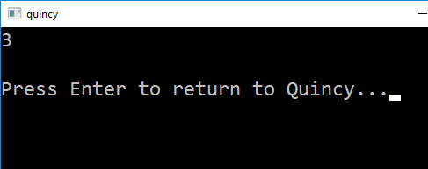
Strong VS Weak (or Loose)
To what degree does a statically typed language allow implicit type conversion?
C is weakly typed.
Happy to perform all manner of implicit conversion without warning or error.

Slide 74
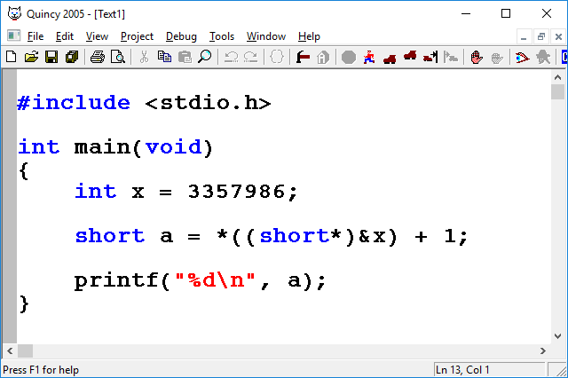
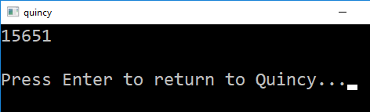
Strong VS Weak (or Loose)
In C, pointer arithmetic can be used to completely bypass the type system:
Here, we’re using pointer arithmetic to read the right-most 2 bytes of in integer as a short.
This can be done with any two types.
We can read the rightmost 4 bytes of a double as an int, etc.
We can treat memory any way we want

Slide 75

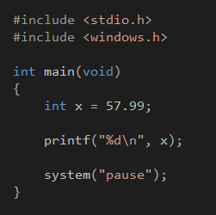
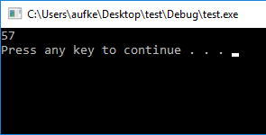
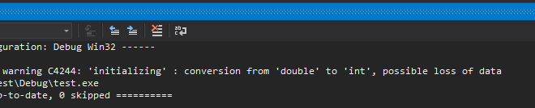
Strong VS Weak (or Loose)
C++ will give warnings where C did not, but still compiles and runs no problem:

Slide 76

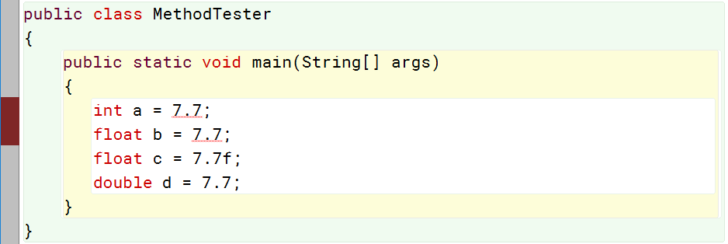
Strong VS Weak (or Loose)
Java will throw compile errors when a loss of precision occurs:
No implicit truncation from floating point to integer
Floating point constants are double precision
Need to indicate single precision explicitly

Slide 77
Java will throw compile errors when a loss of precision occurs:
Careful! Loss of precision does not only occur when going from floating point type to integer type!
int is 32 bits two’s complement.
float is a 23-bit mantissa multiplied by an 8 bit multiplier.
32-bit:
0 1 0 0 0 0 0 1 0 0 0 1 0 0 0 0 0 0 0 0 0 0 0 0 0 0 0 0 0 0 0 0
sign bit
Exponent (8 bits)
Mantissa (23 bits)

Slide 78
int is 32 bits two’s complement.
float is a 23-bit mantissa multiplied by an 8 bit multiplier.
32-bit:
0 1 0 0 0 0 0 1 0 0 0 1 0 0 0 0 0 0 0 0 0 0 0 0 0 0 0 0 0 0 0 0
sign bit
Exponent (8 bits)
Mantissa (23 bits)
If our integer requires more than 23 (roughly speaking) bits to represent, we will LOSE PRECISION by assigning it to a float, and Java will not complain.

Slide 79
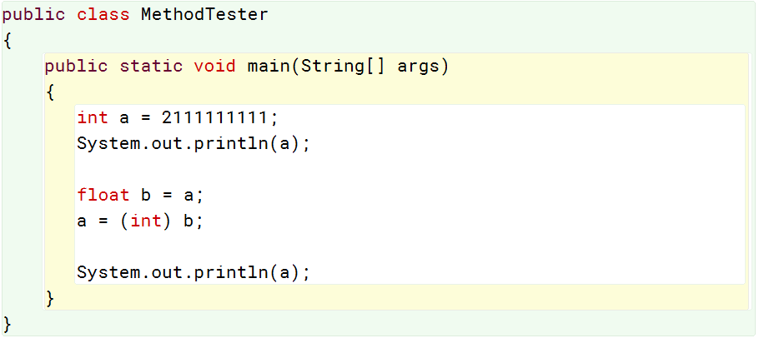
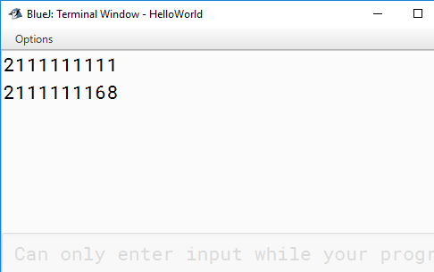

IEEE-754

Slide 80


Slide 81
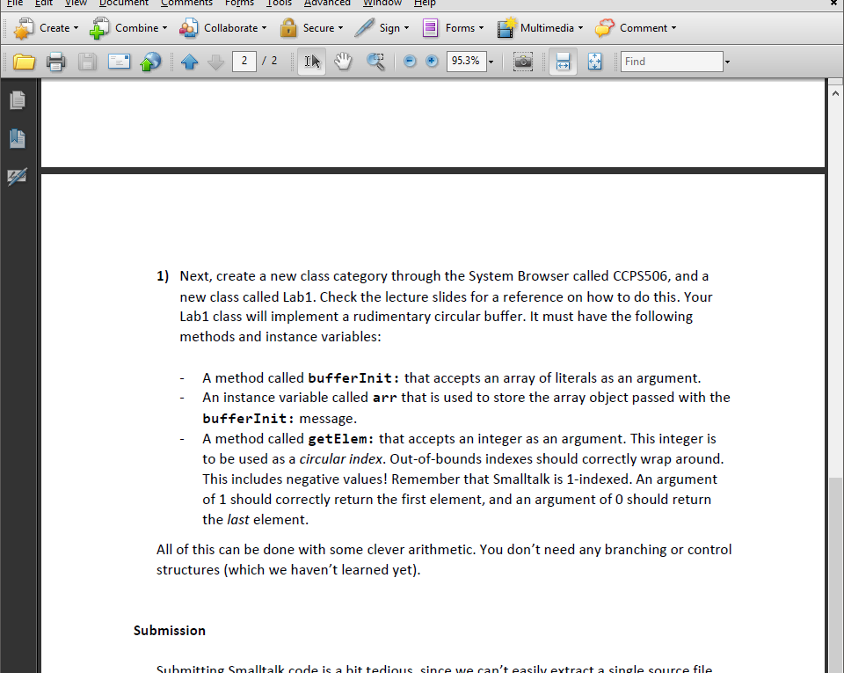
Lab #1

Slide 82
Lab #1
getElem: index
^ arr at: ((index - 1) \\ (arr size)) + 1.
Subtract 1 to account for Smalltalk being 1-indexed
Index rem array size to wrap around, add 1 again.
(arr size) is last element!

Slide 83
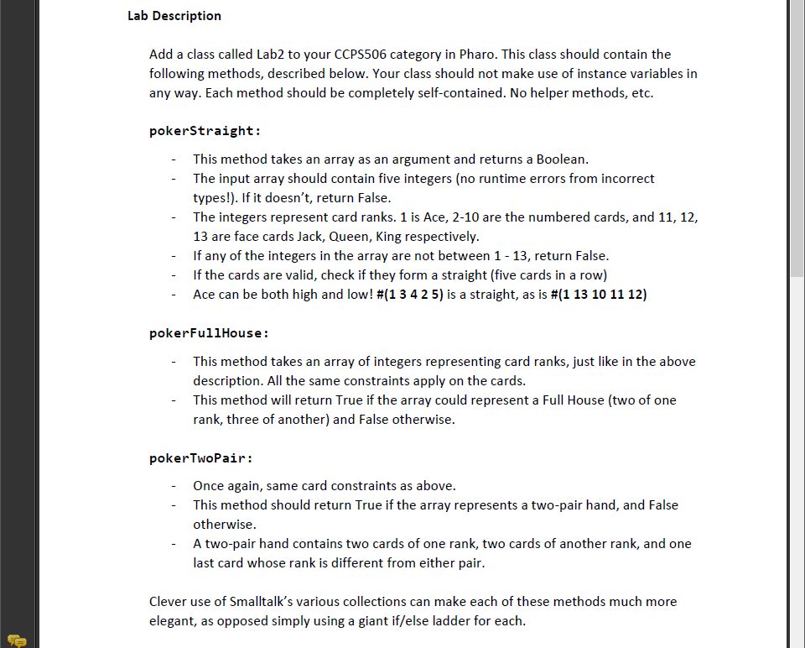
Lab #2

Slide 84
Lab #2
Helper method to validate hand:
Return false if:
Size != 5
Any non-integers
Any outside 1-13
validateHand: hand
hand size = 5 ifFalse: [^false].
hand do: [ :e |
e isInteger ifFalse: [^false].
(e between: 1 and: 13) ifFalse: [^false].
].
^true

Slide 85
Lab #2
pokerStraightSol: arrIn
| hand |
hand := arrIn asArray.
(self validateHand: hand) ifFalse: [^false].
hand asSet size = 5 ifFalse: [^false].
hand := hand asSortedCollection asArray.
hand = #(1 10 11 12 13) ifTrue: [^true].
hand last - hand first = 4 ifTrue: [^true].
^false.

Slide 86
Lab #2
pokerFullHouseSol: arrIn
| hand |
hand := arrIn asArray.
(self validateHand: hand) ifFalse: [^false].
hand asSet size = 2 ifFalse: [^false].
n := hand occurrencesOf: (hand at: 1).
^ (#(2 3) includes: n)

Slide 87
Lab #2
pokerTwoPairSol: arrIn
| hand |
hand := arrIn asArray.
(self validateHand: hand) ifFalse: [^false].
hand asSet size = 3 ifFalse: [^false].
hand := hand asSortedCollection asArray.
(hand occurrencesOf: (hand at: 1)) > 2 ifTrue: [^false].
(hand occurrencesOf: (hand at: 3)) > 2 ifTrue: [^false].
(hand occurrencesOf: (hand at: 5)) > 2 ifTrue: [^false].
^true

Slide 88
Lab #2
Separates 2-pair from 3-of-a-kind
(hand occurrencesOf: (hand at: 1)) > 2 ifTrue: [^false].
(hand occurrencesOf: (hand at: 3)) > 2 ifTrue: [^false].
(hand occurrencesOf: (hand at: 5)) > 2 ifTrue: [^false].
Hand will be one of the following:
#{a, a, b, b, c}
#{a, a, b, c, c}
#{a, b, b, c, c}

Slide 89
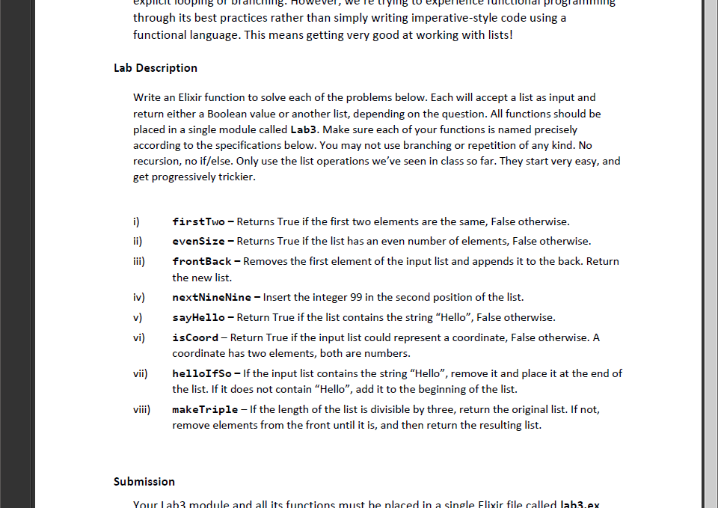
Lab #3

Slide 90
Lab #3
def firstTwo(list), do: hd(list) == hd(tl(list))
def evenSize(list), do: rem(length(list), 2) == 0
def frontBack(list), do: tl(list) ++ [hd(list)]
def nextNineNine(list), do: [hd(list), 99 | tl(list)]
def sayHello(list), do: length(list) != length(list--["Hello"])
def isCoord(list) do
length(list) == 2 &&
is_number(hd(list)) && is_number(hd(tl(list)))

Slide 91
Lab #3
helloIfSo
list = [2,2,3,4,5,"hello",6,7,8,9,10]
addToBack = list -- (list -- ["hello"])
Will be:
[“Hello”] if list contained “Hello”
[] if it didn’t

Slide 92
Recall:
Boolean:
true, false
&&, ||, !
With these operators:
non-false and non-nil is true.
nil and false are false.
iex> "gh" && false
false
iex> "gh" || false
"gh"
Except…
The result isn’t true or false
It’s the value that resulted in true or false

Slide 93
Lab #3
helloIfSo
list = [2,2,3,4,5,"hello",6,7,8,9,10]
addToBack = list -- (list -- ["hello"])
addToFront = (addToBack == []) && ["hello"] || []
true or false
["hello"] or false
["hello"] or []

Slide 94
Lab #3
helloIfSo
list = [2,2,3,4,5,"hello",6,7,8,9,10]
addToBack = list -- (list -- ["hello"])
addToFront = (addToBack == []) && ["hello"] || []
If 1st operand is false, return 1st
If first operand is true, check 2nd
If 2nd is true, return 2nd
(addToBack == []) -> true
true && [“hello”] -> [“hello”]
[“hello”] || [] -> [“hello”]
If 1st operand is true, return 1st
If first operand is false, check 2nd
If 2nd is true, return 2nd

Slide 95
Lab #3
helloIfSo
list = [2,2,3,4,5,"hello",6,7,8,9,10]
addToBack = list -- (list -- ["hello"])
addToFront = (addToBack == []) && ["hello"] || []
(addToBack == []) -> false
false && [“hello”] -> false
false || [] -> []

Slide 96
Lab #3
helloIfSo
list = [2,2,3,4,5,"hello",6,7,8,9,10]
addToBack = list -- (list -- ["hello"])
addToFront = (addToBack == []) && ["hello"] || []
res = addToFront ++ (list -- ["hello"]) ++ addToBack
Remove [“hello”] from original list
Add addToFront to the beginning
Add addToBack to the end

Slide 97
Lab #3
helloIfSo
list = [2,2,3,4,5,"hello",6,7,8,9,10]
addToBack = list -- (list -- ["hello"])
addToFront = (addToBack == []) && ["hello"] || []
res = addToFront ++ (list -- ["hello"]) ++ addToBack

Slide 98
Lab #3
makeTriple
def divByThree(li), do: rem(length(li), 3) == 0
def makeTriple(list) do
((divByThree(list) && list) ||
(divByThree(tl(list)) && tl(list))) ||
tl(tl(list))
end

Slide 99
Have a great reading week!

